Slide 1

Domestic Violence
against Woman
September 23, 2021 Ayiti Analytics final project Cohort may-september 2020

Slide 2
Agenda
01 Introduction
Problem
02 Goals of the project
Goals
03 Methodology
Describing the process of the project
04 EDA
Providing insight about the data
05 Model
Choice of the model
06 Solution

Slide 3

Context
In Haiti, domestic violence is a serious problem, with survey results suggesting that approximately 27300 women suffer from physical and/or sexual violence. This corresponds to 9.4% of the population between the ages of 14 and 49, according to COPENAGH.
Domestic violence has far-reaching consequences for women's and girls' development and well-being, preventing them from living safely and causing physical and psychological injuries that undermine their ability to lead a normal life, access the education they need, earn a living, build a future and participate in public life. This not only causes pain and suffering to the victims, but also costs society. Victims are more likely to commit suicide. Children raised in violent households are also more likely to become victims or perpetrators of violence.

Slide 4
Goals of the project
The objective of my project is:
To study the factors that are related to domestic violence.
the profiles of the victims in order to bring a solution of sensitization to the agressors and to eradicate domestic violence.

Slide 5

Background
For every 1,000 women between the ages of 15 and 19, 150 of them have at least been victimized in Haiti, the highest proportion of any other age group..

Slide 6


Problem
- Deterioration of the quality of life
-Attempted murder
Absence du travail en raison de maladie
-Interruption of daily activities
- Perpetuation of women's low status
These consequences of domestic violence are problems to which our project wants to try to find a solution..

Slide 7

Audience
All young women and girls
Associations working against violence against woman
The different institutional and associative partners

Slide 8
Data source
EMMMUS-IV
2016-2017:
Data were collected on EMMUS –VI (Survey on Mortality, Morbidity and service utilization in Haiti) among 9795 people in Haïti.

Slide 9

Methodology
Cleaning and analysis
Cleaning data and EDA using Python and Pandas and Numpy
Modeling
Building a Machine Learning Classification Model with Python
Recommendation
Propose recommendation to the different organizations defending women’s rights or fighting against domestic violence.

Slide 10
Question of research
What is the profiles of women who are victims of violence?
How can woman victims of domestic violence be accompanied?

Slide 11
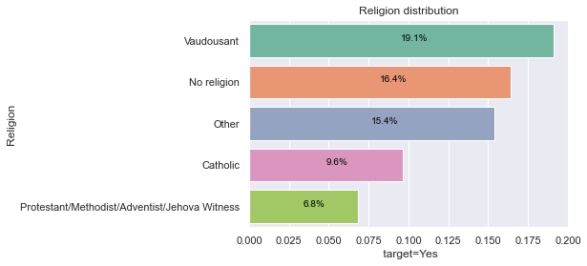
Percentage of Violence by Religion
Women who are Voodooists, No religion, other are much more victims of domestic violence.
We can also see that the Voodooists and the Others are 2 to 3 times more victims than the Catholics and the Protestants.

Slide 12
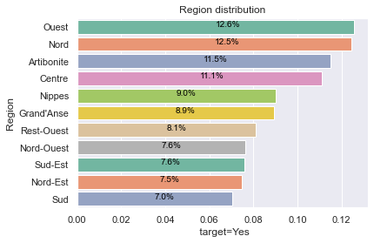
Percentage of Violence by Region
Regarding to the first 3 regions, women who are from:
West:
North:
Artibonite:
are much more victims of domestic violence.
We can therefore say that women from Artibonite, West and North are twice as much victims as the other regions.

Slide 13
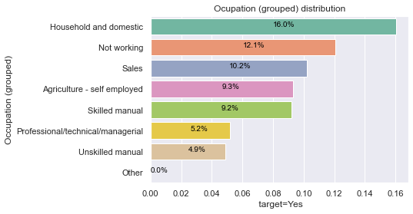
Percentage of Violence by Occupation (grouped)
In terms of occupation, women who are Household and domestic, Not working and Sales are more victims of domestic violence.
We can also see that this is the highest proportion compared to the other occupation groups.

Slide 14
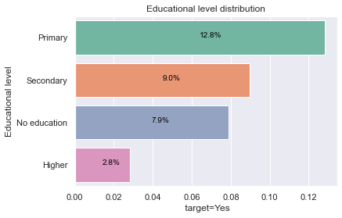
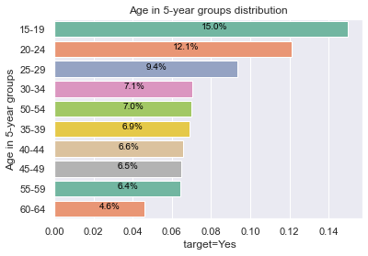
Percentage of Violence by Educationnal level & Age in 5-year groups
Women of primary, secondary and no education level are 3 times more beaten compared to those of higher education level.
women who are in the age group: 15-19, 20-24 and 25-29 are the most beaten.

Slide 15
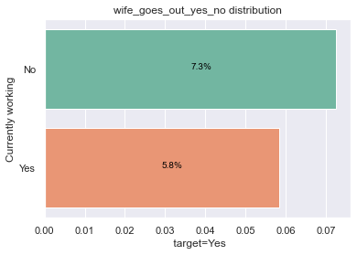
Percentage of Violence by Wife_goes_without_telling_husband
Women who go out without telling their partner are much more victimized than those who tell their partner.
Pami moun ki victim de violence domestic,moun ki pp travay yo pran plus baton le yo sortti san yo pa di mari yo ke moun kap travail yo.

Slide 16
Features | Target
Educational level Religion Region Ever been married or not Occupation | Beating(Yes/No) A categorical variable
Keys Variables

Slide 17
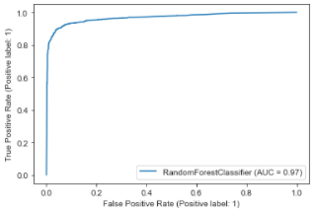
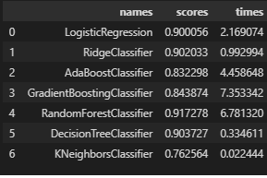
Classification Model
A Machine Learning approach is used, specifically supervised learning, to determine the probability of a woman being a victim of domestic violence.
The best performing model is RandomForestClassifier because it can predict a 91% profile of women likely to be victims of domestic violence.
Machine learning is used to predict a model to determine the characteristics of women likely to be victims of domestic violence.

Slide 18
AUC (Area under the Curve) = 0.97 represents the degree or measure of separability. The higher the AUC, the better the model is able to predict that class 0 is 0 and class 1 is 1. By analogy, the higher the AUC, the better the model is able to distinguish between women who are likely to be victims of domestic violence and those who are not.

Slide 19
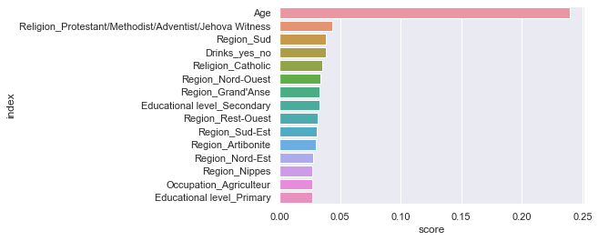
Important Variable
Here we have the 15 most importants variables according to our model: RandomForestClassifier.

Slide 20
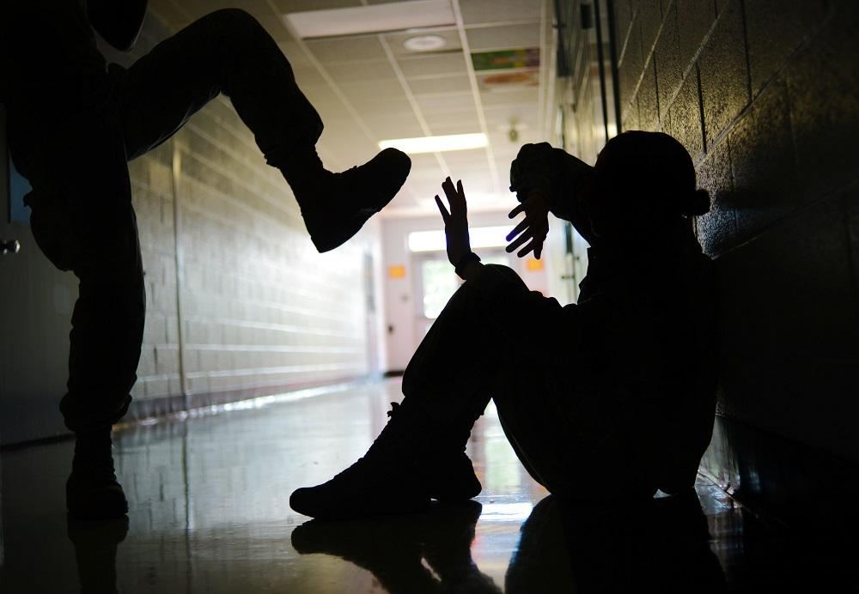

Slide 21
My finding
According to the data
The mean age of Beating justified: wife refuses to have sex with husband is 30.29; and 3% of them are victims.
The mean age of Beating justified: wife neglects children is 26.51; and 5% of them are victims.
The mean age of Beating justified: wife goes out without telling husband is 29.31; and 6% of them are victims.
The mean age of Beating justified: wife argues with husband is 27.02; and 1% of them are victims.
The mean age of Beating justified: wife burn food is 28.16; and 2% of them are victims .
15%, 12%, 9% of battered women are successively of the following age groups: 15-19, 20-24, 25-29 years old;
12.6%, 12.5%, 11.5% of them are from the religion: North, West and Artibonite;
12.8% of them have no primary education;
Of these women, 10% are victims of domestic violence.

Slide 22
Recommendation
1- Intensify public awareness campaigns, especially those aimed at men, to make them understand that they do not have the right to raise their hands on a woman under any circumstances.
2- Ensure that the judicial system continues to prosecute the perpetrators of these acts, so that in the future they will know how to adopt a positive attitude towards women.
3- Victims should file complaints to existing structures such the Ministry of Women’s Affairs and other women’s rights organizations.
How can victims of domestic violence be accompanied?

Slide 23
Conclusion
Violence makes victims feel fear, guilt, shame and isolation. These reactions are normal, it is the situation that is not. This leads to major problems: stress, anxiety, depression, insomnia, etc. Violence destroys well-being and degrades health. All aspects of life are affected: family, work and social life.
Together let's say "NO" to Domestic Violence.

Slide 24
References & Appendices
Link of the project’s GitHub repository:
https://github.com/kettenieF20/Final-Capstone-Project

Slide 25


Thénéus Ketenie Flore
Manager to be
Data Analayst to be
ketteniefloretheneus@gmail.com
+509 36299266\ 43766153
Thank you!

